Slide 1
Bargaining with GPT in Alternating-Offer Games
Nobuyuki Hanaki & Yuhao Fu & Haitao Wang
The University of Osaka

Slide 2
Why Important
•AI is now used to negotiate directly with people, not just to support decisions (e.g., in customer bargaining and business negotiations), so it is important to understand how humans respond when the counterpart is an AI.
•Most prior studies focus on one-shot games. we hopefully provide some interesting insights into how behavior changes over time.

Slide 3
Research Question
• Do humans behave differently when bargaining with AI versus humans in an alternating-offer game?
• When the AI’s earnings may be linked to other players’ earnings, does this affect how humans bargain and make decisions?

Slide 4
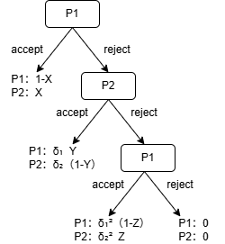
Main Task
Role：P1 and P2( randomly assigned)
discount rate：δ₁=0.6 δ₂=0.4
round : 10 rounds

Slide 5
Treatment
T1: human vs human (n = 26)
• One of the ten rounds is randomly selected, and the points earned in that round determine the final payoff.
T2: human vs AI(GPT 4o)(n = 26)
① One of the ten rounds is randomly selected, and the points earned in that round determine the final payoff.
② Payoff comes from the AI’s earnings in the same round, where the AI plays the same role (P1 or P2) against other subjects.
T3:human vs AI(GPT 4o)(n = 26)
• One of the ten rounds is randomly selected, and the points earned in that round determine the final payoff.

Slide 6
AI Prompt
Proposer：
prompt = f"""You are the proposer in a 3-stage alternating-offers bargaining game over {C.ENDOWMENT} points.Goal: maximize your own discounted payoff. Your opponent is human。
Rules:
- You propose how many points to give to your opponent (0-{C.ENDOWMENT})
- You keep the remaining points
- If the offer is rejected, the game moves to the next stage with higher discounts
- If this is stage {C.MAX_STAGE}, this is the last chance to make a deal
Based on the negotiation history and current situation, what points would you offer to your opponent?
Please respond with ONLY a number between 0 and {C.ENDOWMENT}."""

Slide 7
AI Prompt
Responder：
prompt = f"""You are playing a 3-stage alternating-offers bargaining game. Here's the situation:
Should you ACCEPT or REJECT this offer? Consider:
1. The discounted value you would receive now
2. The risk of getting worse terms (or zero) if negotiations continue
3. Strategic considerations based on the stage and negotiation history
4. Whether the opponent is making concessions or becoming more aggressive
Respond with ONLY one word: ACCEPT or REJECT"""

Slide 8
Hypothesis
• When the AI keeps its own payoff, humans tend to act more selfishly: they make more unfair offers to the AI and are less willing to accept unfair offers from the AI.
• When the AI’s payoff may affect other players’ payoffs, humans tend to make relatively fairer offers and are more willing to accept unequal offers.

Slide 9
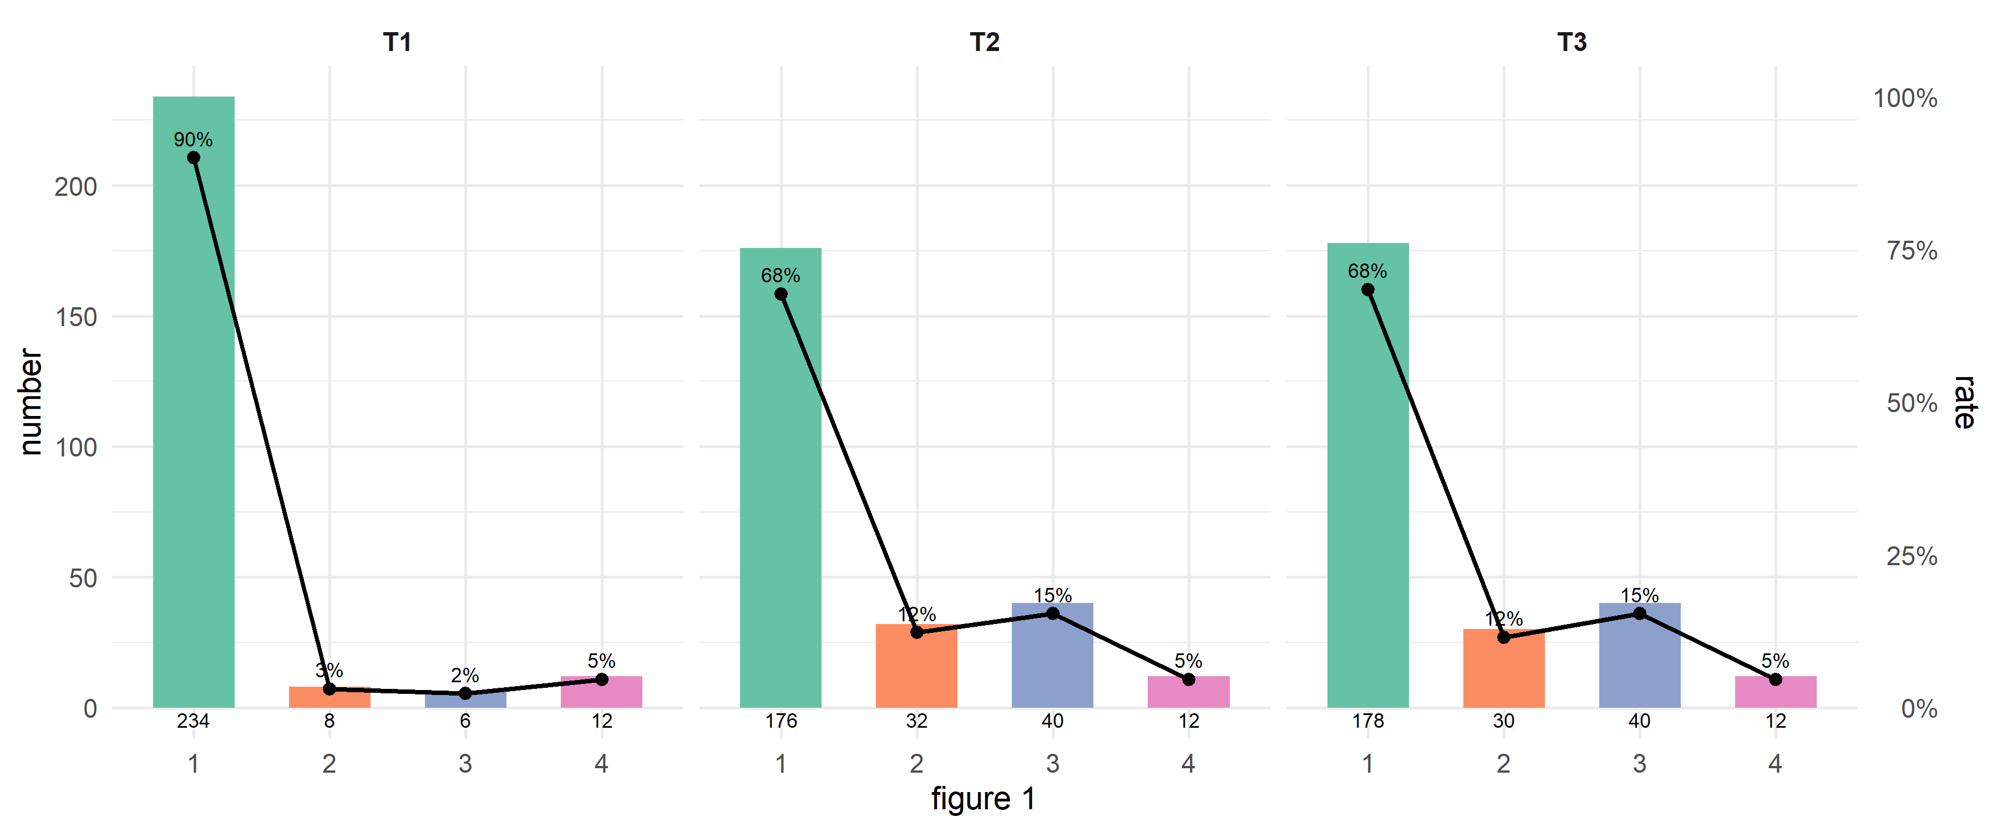
Results
Stage-End Counts by Treatment

Slide 10
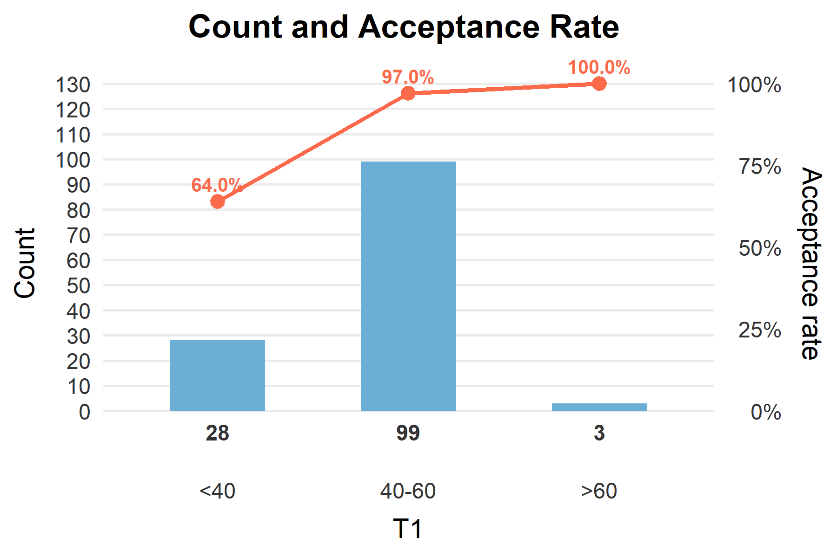
Results

Slide 11
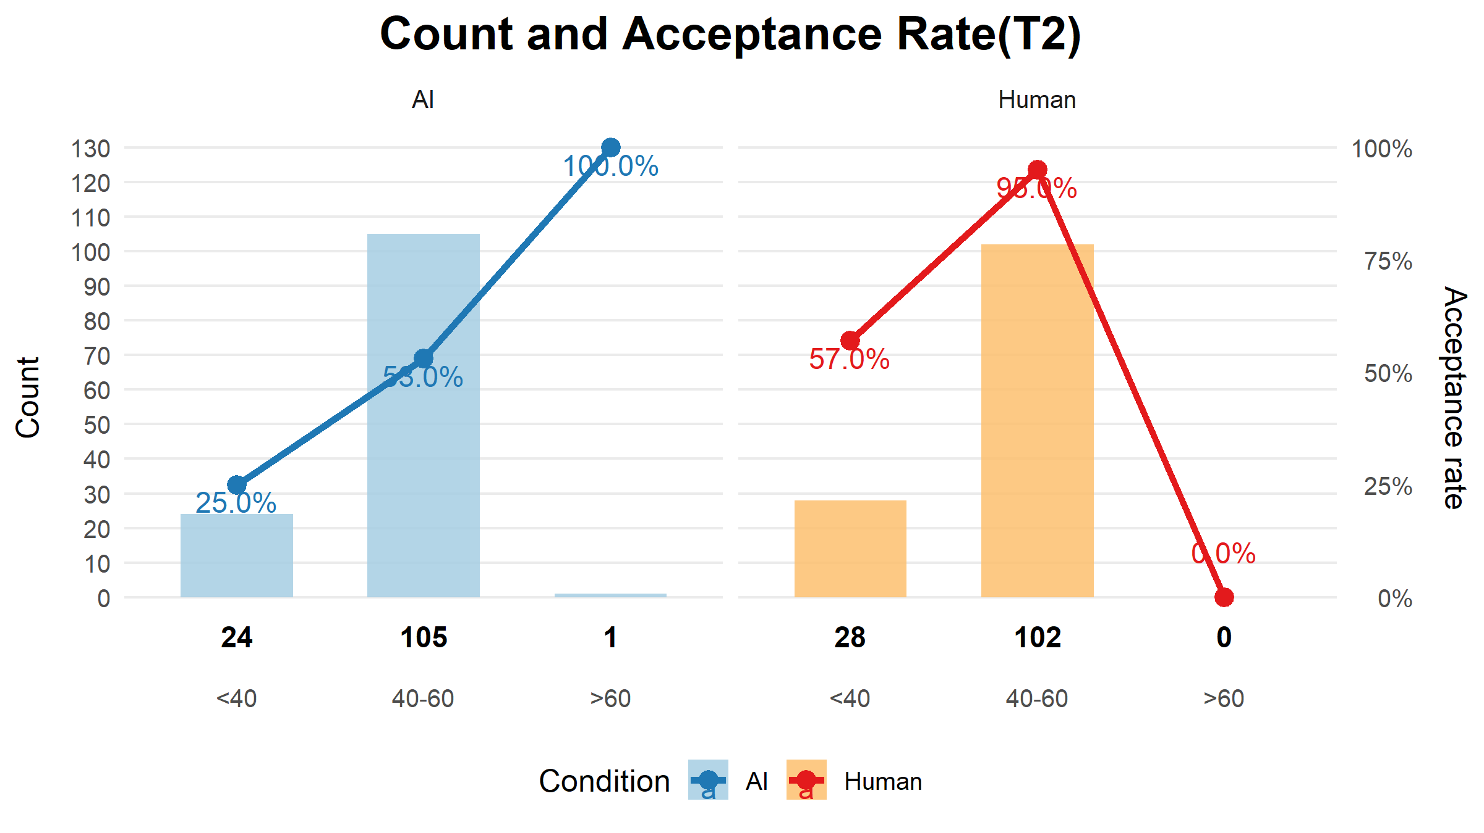
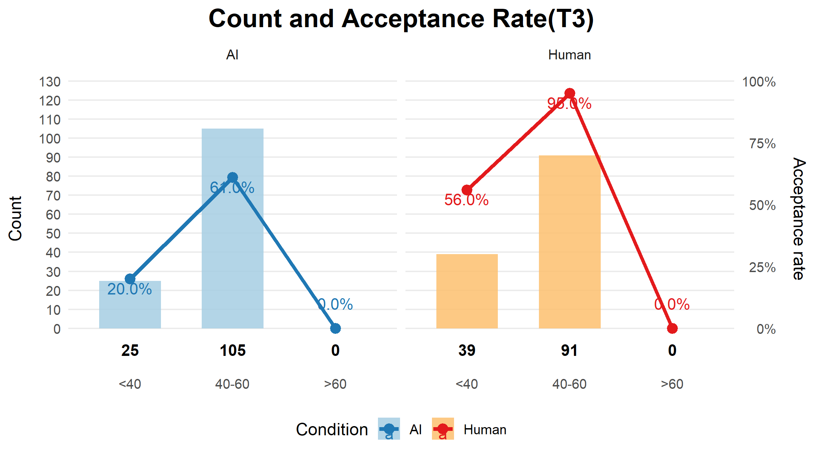
Results

Slide 12
Results
Across all treatments, human responders (P2) almost never reject a 50–50 offer. In contrast, when the AI is P2, its acceptance rate for this fair offer is only 69% in T2 and 80% in T3.
• In Stage 1, when the AI is P2 (responder), it may behave more selfishly and be stricter about offers from humans.

Slide 13
Regression
stage 1 human (P1)
offerᵢ = α₀ + α₁·AIᵢ + α₂·Transferᵢ + α₃·Roundᵢ + εᵢ
• α₀: baseline offer
• α₁ (AI):effect of AI vs human opponent
• α₂ (Transfer): effect of transfer condition
• α₃ (Round): change per round (time trend)
AI = 1 for T2/T3, 0 for T1 (human opponent).
Transfer = 1 for T2, 0 for T3.

Slide 14
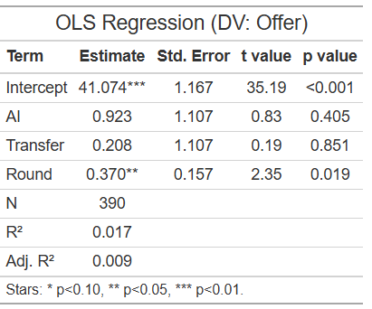
Regression
n=390
We use two-sample KS tests to compare the distribution of offers between groups. The results are generally consistent with the main findings.
• T1 vs T3(AI): KS D = 0.092308, p-value = 0.6369
• T2 vs T3(Transfer): KS D = 0.069231, p-value = 0.9144

Slide 15
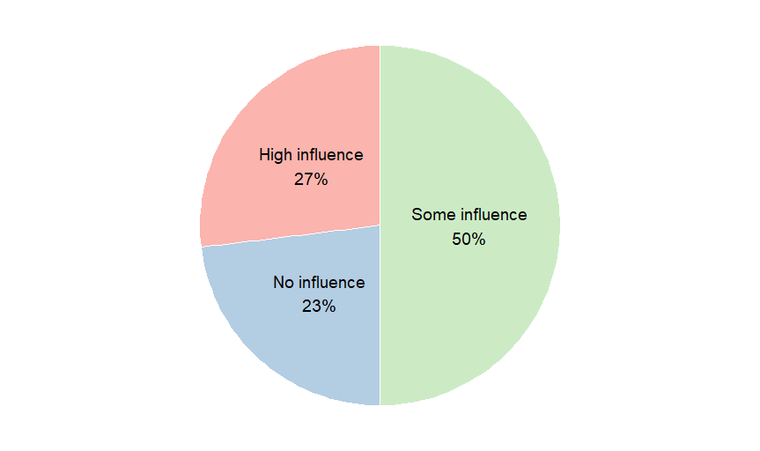
Regression
However, in the questionnaire we asked: “Does knowing your opponent is an AI affect your decisions?” Most participants in T2 and T3 answered that it has some effect.
n=52

Slide 16
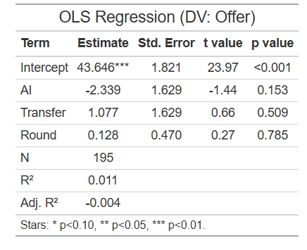
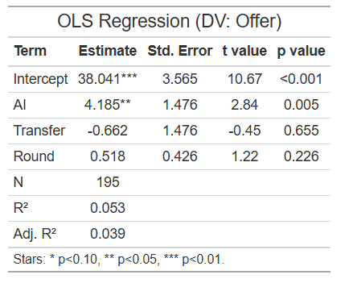
Regression
So, we ran separate regressions for the first five rounds and the last five rounds.
n=195
n=195
First Five Rounds
Last Five Rounds
• T1 vs T3 : KS D = 0.15385, p-value = 0.2518(First Five Rounds)
• T1 vs T3: KS D = 0.26154, p-value = 0.01047(Last Five Rounds)

Slide 17
Results
• At the beginning, participants may not know how to bargain with the AI. As rounds go on, when the opponent is AI, they tend to make higher offers.
• There is no clear trend showing that linking the AI’s payoff to other subjects affects the offers made by humans.

Slide 18
Regression
stage 1 human (P2)
Pr(Acceptᵢ = 1) = Φ( β₀ + β₁·AIᵢ + β₂·Transferᵢ + β₃·Offerᵢ )
β₀: baseline acceptance level
β₁: AI vs human effect on acceptance
β₂: transfer-condition effect on acceptance
β₃: effect of a higher offer on acceptance

Slide 19
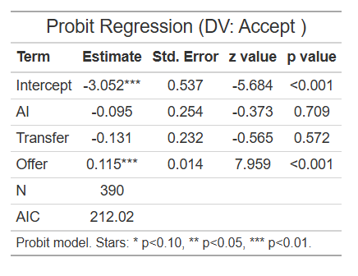
Regression
We use Fisher’s exact tests to compare acceptance rates between groups. The results are generally consistent with the main findings.
T1 vs T3: OR = 0.58 , p-value = 0.20(Fisher’s exact test).
T2 vs T3: OR = 1.28 , p-value = 0.60 (Fisher’s exact test).

Slide 20
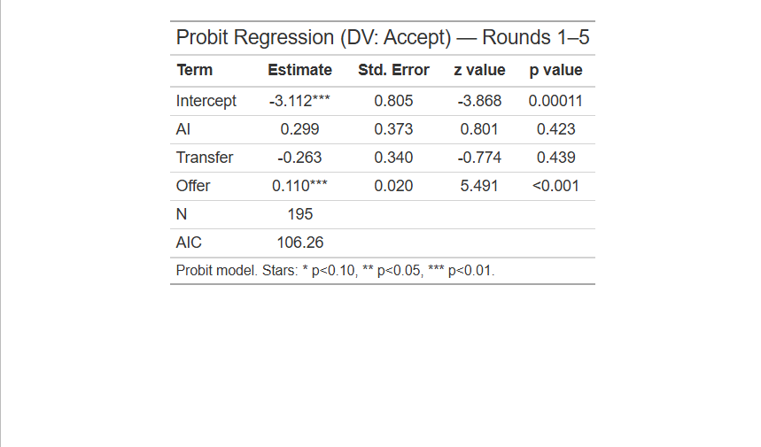
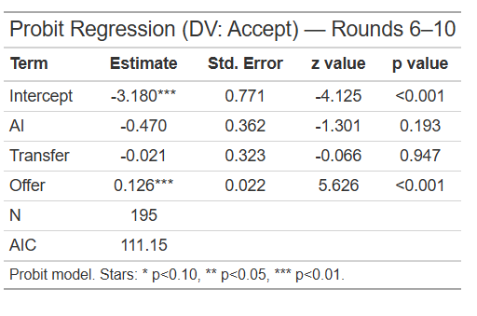
Regression
• Similarly, we ran separate regressions for the first five rounds and the last five rounds. In both cases, the coefficients on AI and Transfer are not significant.

Slide 21
Results
In Stage 1, when humans are P2 (the responder), they do not seem to strongly differentiate whether the opponent is AI or human, or whether the AI’s payoff may affect others. Instead, they appear to care more about the offer amount.

Slide 22
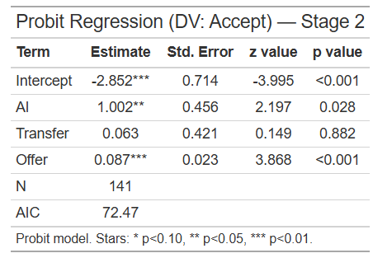
Regression
stage 2 human (P1)(offer at stage 1 rejected)
T1 vs T3(AI): OR = 1.45 , p-value = 0.76(Fisher’s exact test).

Slide 23
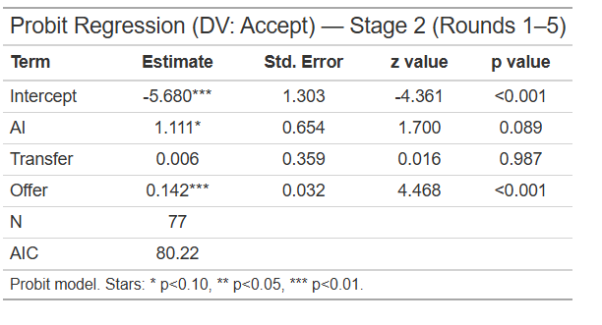
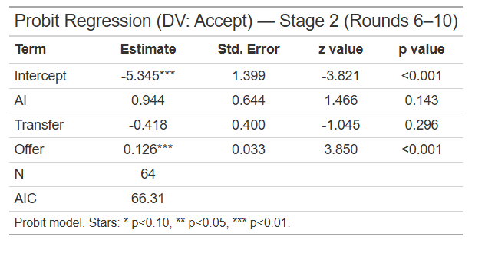
Regression

Slide 24
Results
In Stage 2, when humans are P1 (the responder), they still care about the offer amount.
One possible explanation for the AI effect is that after having their Stage 1 offers rejected, participants may learn that the AI can reject offers and may care about fairness. As a result, they may be more willing to accept offers from the AI.

Slide 25
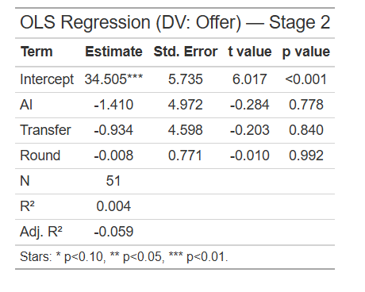
Regression
stage 2 human (P2)(offer at stage 1 rejected)
• T1 vs T3 : KS D = 0.28571, p-value = 0.2759
• T2 vs T3: KS D = 0.11485, p-value = 0.9382

Slide 26
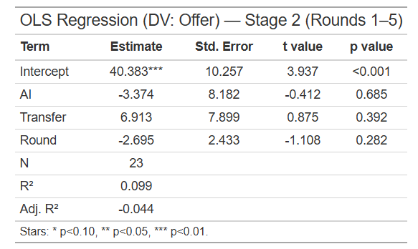
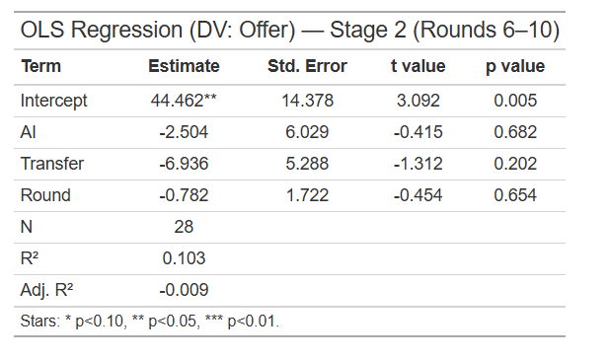
Regression

Slide 27
Results
In Stage 2, when humans are P2 (the proposer), we do not find clear evidence that facing an AI, or the AI payoff transfer condition, affects the offers humans make.

Slide 28
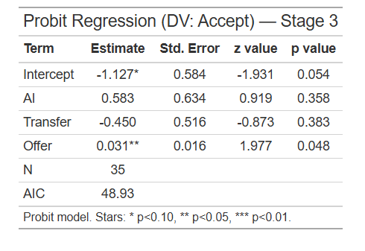
Regression
stage 3 human (P2)(offer at stage 2 rejected)
T1 vs T3(AI): OR = 3.8 , p-value = 0.21(Fisher’s exact test).
T2 vs T3(AI): OR = 2.3 , p-value = 0.42(Fisher’s exact test).

Slide 29
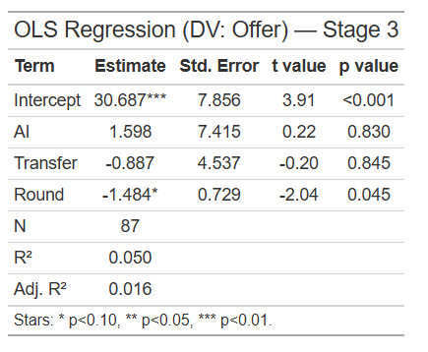
Regression
stage 3 human (P1)(offer at stage 2 rejected)
• T1 vs T3 : KS D = 0.42342, p-value = 0.05544
• T2 vs T3: KS D = 0.18457, p-value = 0.3071

Slide 30
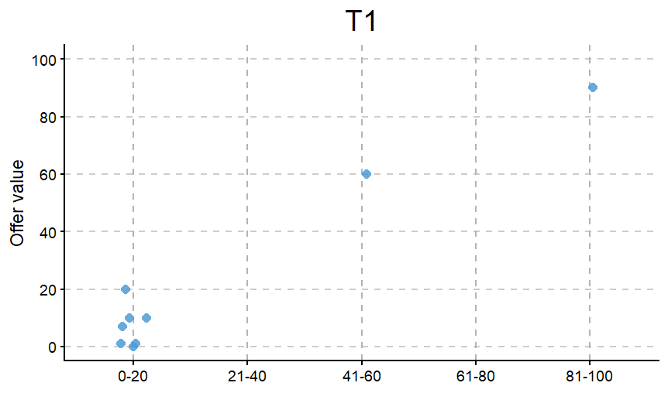
Regression

Slide 31
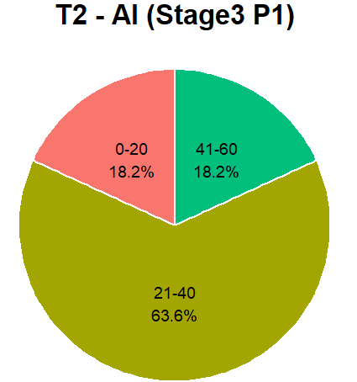
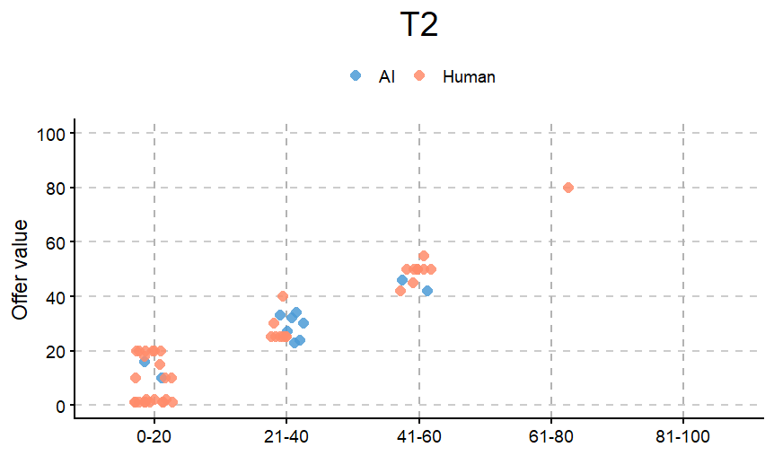
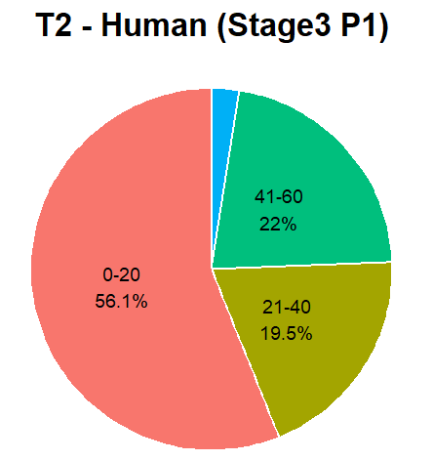
Regression

Slide 32
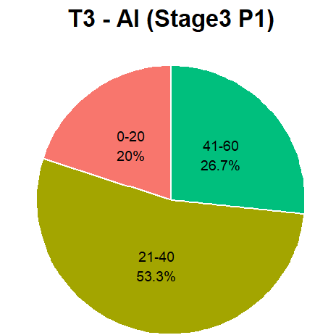
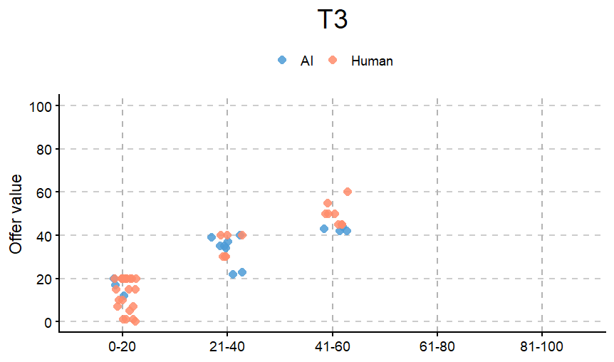
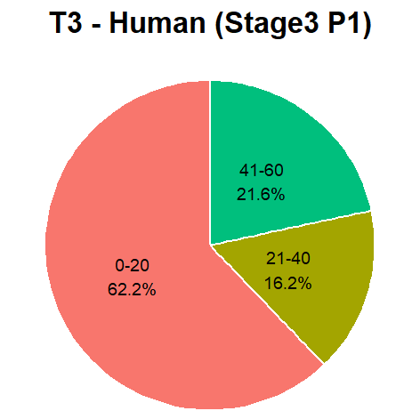
Regression

Slide 33
Results
In Stage 3, when humans are P1 (the proposer), their offers tend to be lower. In contrast, when the AI is P1, it tends to make more generous offers to humans.
When humans are P2, whether they accept an offer seems to depend mainly on the offer amount.

Slide 34
Transfer
One possible reason why the Transfer variable is often not significant :
we only told T2 participants there were two payoff calculation methods, but did not clearly tell them that their bargaining could affect other players’ earnings.

Slide 35
Other Findings
Punishment Behavior
In Stage 2, we examine how humans behave as P2 after receiving an unfair offer (below 40) as P1—specifically, what offer they make to the opponent. We have 39 observations.
• In T1, 50% of participants (5/10) chose to retaliate against an unequal offer.
• In T2, 50% of participants (6/12) chose to retaliate against an unequal offer.
• In T3, 47% of participants (8/17) chose to retaliate against an unequal offer.
Among the subjects who chose to retaliate against an unequal offer, 42%(8/17) ended up with fewer discounted points than the points they were offered in Stage 1.

Slide 36
Thank You !

